Slide 1

PHONE PRICES
PREDICTION USING DATA MINING
IT326-2023

Slide 2

PROBLEM
There are numerous companies that provide us with phones with varied features.
comparing the prices of phones from different companies depending on features like brand, operating system, storage, and others could be overwhelming.
build a model that helps people choose the right phone for them taking into consideration the features compared to the price.

Slide 3
DATASET
Our dataset contains phone features including price of popular brands. Every phone in this dataset continues to be manufactured. The dataset doesn’t include discontinued phones, and it consists of 1512 rows and 22 attributes which are:
phone_name
resolution
announcement_date
video_1080p
video_120fps
brand
battery
weight_g
video_4K
video_240fps
operating system (os)
storage_GB
video_8K
battery_type
video_480fps
ram_GB
video_720p
video_30fps
inches
video_960fps
price_USD
dataset source:https://www.kaggle.com/datasets/berkayeserr/phone-prices:

Slide 4
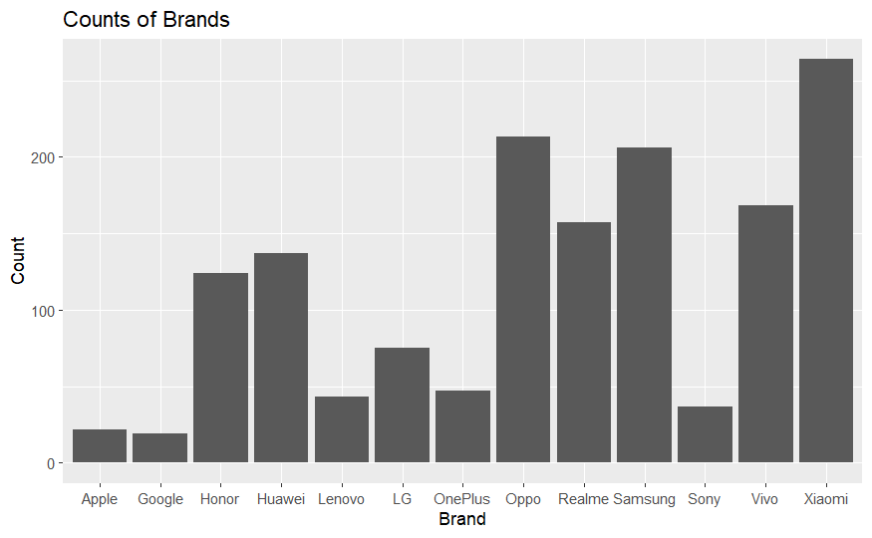
DATA VISUALIZATION
Xiaomi is the brand that produces the most mobiles and Google is the least.

Slide 5
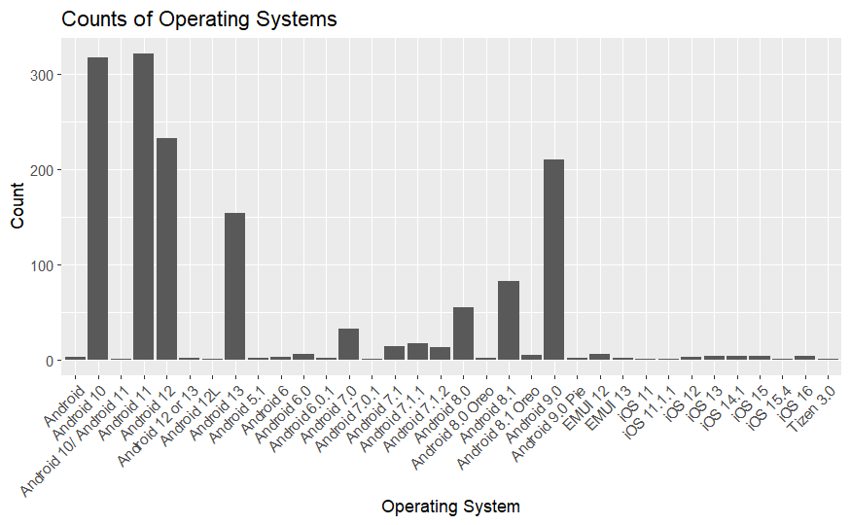
DATA VISUALIZATION
Android 11 and Android 10 are the most operating systems used in phones based on our data

Slide 6
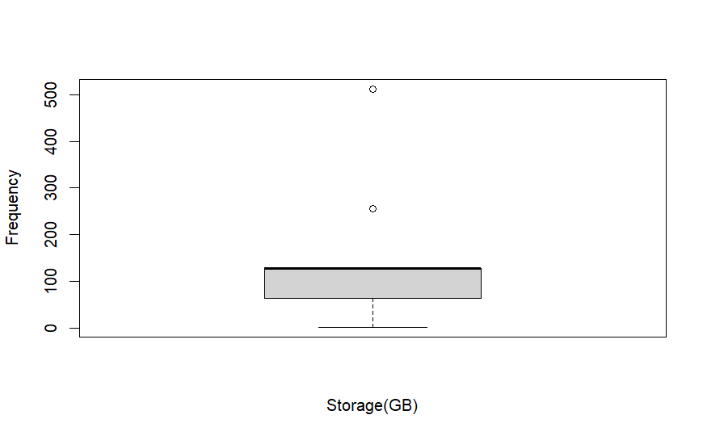
DATA VISUALIZATION

Slide 7
DATA PREPROCESSING
ENCODING
NORMALIZATION
DISCRETISATION
since phones features have significantly different scales, Normalization ensures that no single feature disproportionately
influences the analysis.
we discretized the price column and added labels to the prices by dividing them into 3 categories ("Cheap", " Affordable", and "Expensive")
Noticing logical attributes, and a character attribute
with only two values, we decided to encode the values to simplify the data representation

Slide 8
DATA PREPROCESSING
Data Transformation
Data Reduction
The [phone name] serves as a unique identifier but contains information that is irrelevant and not useful for the data mining task.
extracte the phone announcement year from the announcement_date , as the day and month of the announcement are irrelevant to phone prices
divided the resolution column into height and width for detailed characteristics

Slide 9
DATA PREPROCESSING
Data cleaning
Stratified sampling
replaced phones with noisy OS with the latest operating system under the assumption that they had been updated.
devices utilizing the "Android" operating system, we replaced it with "Android 11," considering it is the most prevalent operating system in our dataset
to ensure that each class in the 'price' column is represented proportionally in both the training and testing sets

Slide 10
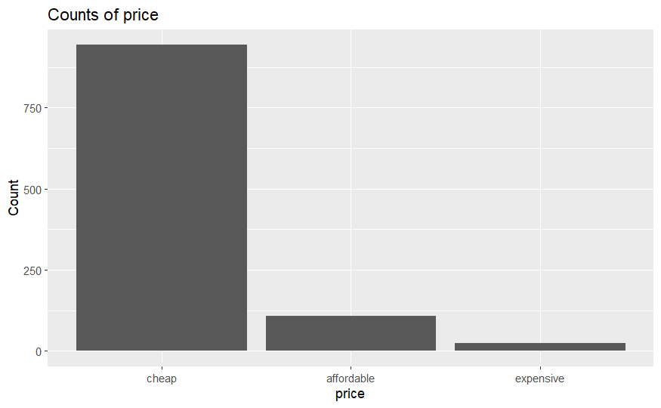
CLASS LABEL
cheap :944 phone
affordable : 109 phone
expensive : 25 phone

Slide 11

DATA MINING TECHNIQUES:
In our project, we used two data mining tasks to help us predict the phone prices which are:
supervised learning
unsupervised learning
Classification
Clustering

Slide 12
CLASSIFICATION
Classification is a type of supervised learning in which data instances are given predefined labels.
We used three different partitioning splits for the training and testing data .
The training dataset: was used for constructing the decision tree model
The testing dataset: was used to evaluate the model's accuracy.
we conducted experiments with different partitioning ratios (70%-30%, 80%-20%, and 60%-40%) and various splitting criteria (ID3, C5.0, and CART).
1
2
3
70% - 30%
80% - 20%
60% - 40%

Slide 13
FINDINGS
Our goal of building a model that effectively classifies phones into "cheap," "affordable," and "expensive" categories remains unachieved.
Across all models, there were difficulties in accurately distinguishing phones that are "affordable" and "expensive".
the best model is C5.0 model in the 70%-30% partition It excels in predicting "cheap" phones (187 out of 189 cheap phones correctly classified) only and it shows some potential in classifying expensive and affordable phones.
Despite using stratified sampling to address imbalanced data, the model faces difficulties in classifying phones as "affordable" or "expensive."
certain brands such as Apple, Google, LG, Samsung, and Sony were associated with predictions of "affordable," while others like Huawei, Lenovo, Oppo, Realme, and Vivo were associated with predictions of "cheap."

Slide 14

CLUSTERING
Clustering is grouping similar objects or data points together based on characteristics or similarities
Main goal: find patterns without prior knowledge or class labels.
There are many types of clustering techniques, but we used k-means; the most widely used technique as it divides the data into a set of predefined number of k clusters, then groups the data based on the closest mean.

Slide 15
CLUSTERING
We used three different value k for the k-mean clustering technique: k=2, k=4, k=6
After calculating the TWSS, precision, and recall, visualizing overlap, then plotting the elbow method, we compared each k cluster.
We then chose k= 4 as the best cluster for our dataset as the elbow method suggested it, as well as it had the best value precision.
k=6 had the best value TWSS but it had more overlap and lower precision value than k=4.

Slide 16
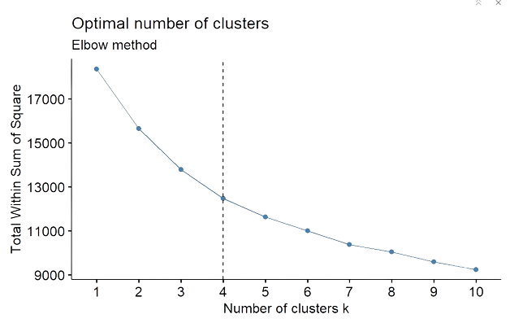
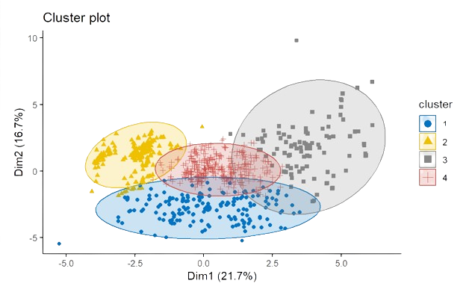
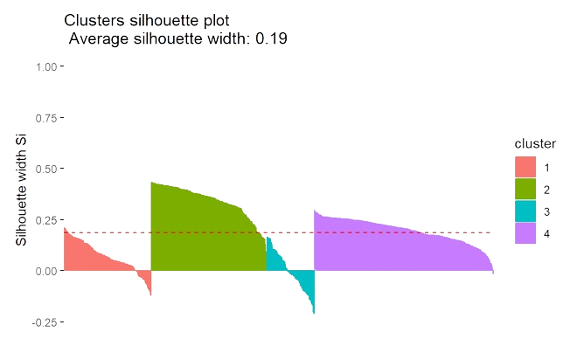
CLUSTERING FINDINGS

Slide 17

THANK YOU VERY MUCH!
Do you have any questions?
PRESENTED BY
SHDAN ALSHEDDI - SHADEN ALBADER - JURI ALSOLAIMI - JOUD ALHUSSAIN

